Slide 1


Pairfect
Matching App
Pairfect
Matching App
X
BY GROUP 18: CODE DUNGEON
Serena Wu&Zoe Luo&Sophie Hou&Clara Zhang&Guiping Zhao

Slide 2
Pairfect
Matching App
Apps Implementation
Details
1
2
Database Description
Object-Orientated Programming
Flat Structure
Databased system: SQLite
Identity:
Each user is uniquely identified by a user ID
Attributes
Gender, ages, location, interest
Behavior: Like & Dislike
Records the matches between users, including a match score calculated by the matching algorithm
3
Pairfect
IDE & Version Control
Matching App
Visual Studio Code
Github

Slide 3



Home Page
Pairfect
Matching App
Matching
Approach
Login In
Sign Up
Exit
Main Menu
Edit Profile
View All Profile
Start Matching
View Matches
Log Out
Data Base Implementation
Weighted Matching Algorithm
Gender : Male or Female
Age: Age gap
Interest: Common interests
Location: Location consistency
Recommendation Based on Similarity
Like/Dislike Functionality
Users’ Reaction
Database Error Handling
X 5
Result

Slide 4
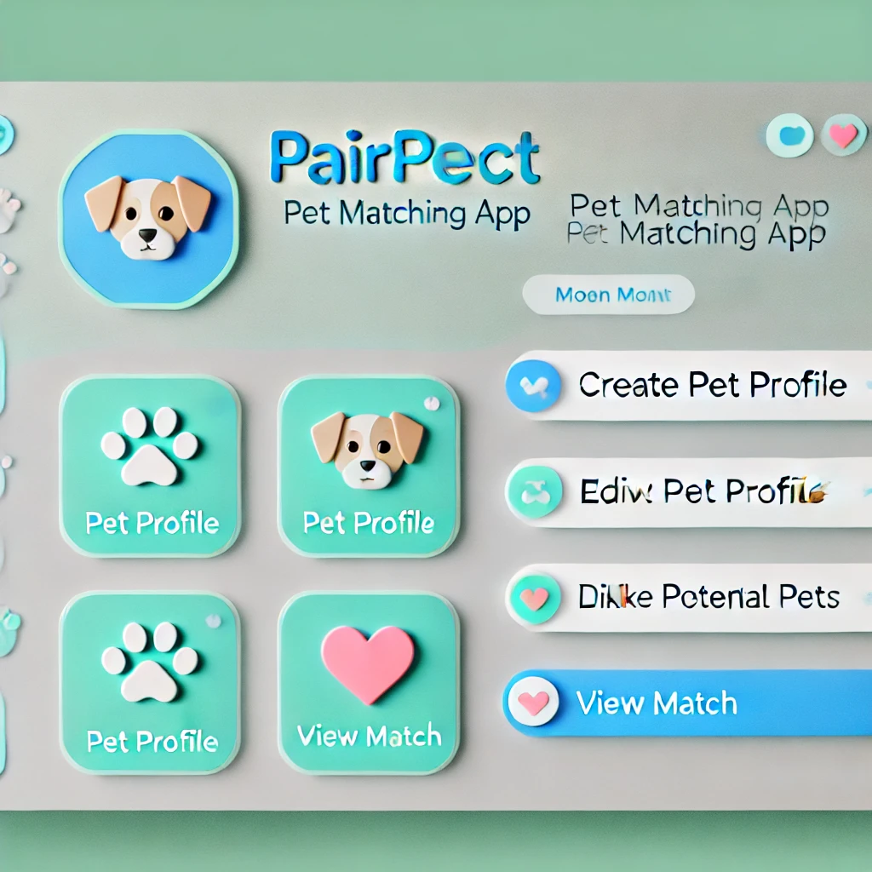
Pairfect
Matching App
Pairfect

Slide 5

Pairfect
Matching App
Download
Now!
Pairfect
Matching App

